Slide 1
module 4 final project
ASAD RAHMAN

Slide 2
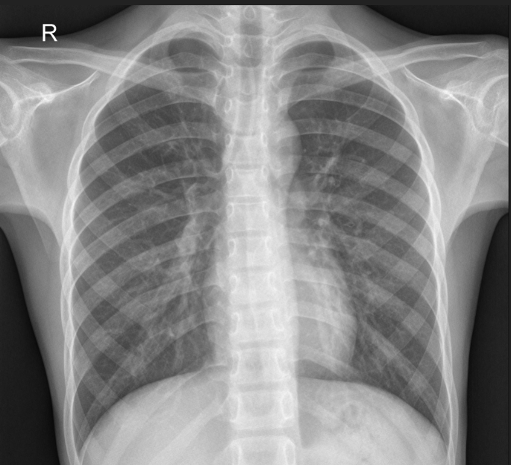
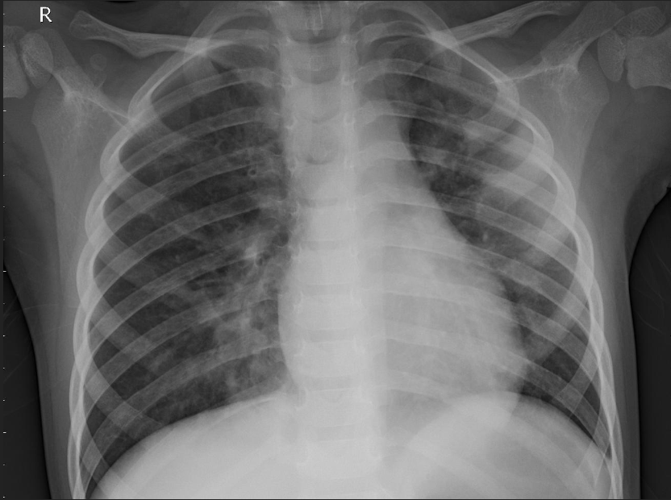
PROJECT AIMS
Increase efficiency in Pneumonia detection in X-rays

Slide 3

METHODOLOGY
DATASET: 5,863 X-Rays
CREATE and TEST MODEL
IMPROVE MODEL with OPTIMIZATION

Slide 4
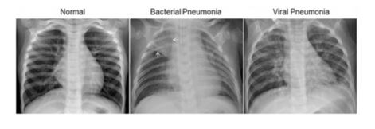
THE DATA
Pediatric patients
One to Five years of age
Guangzhou Women and Children’s Medical Center

Slide 5
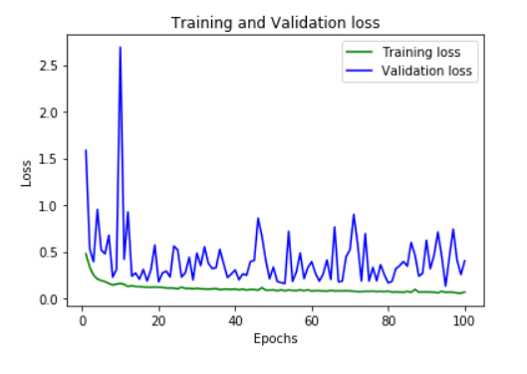
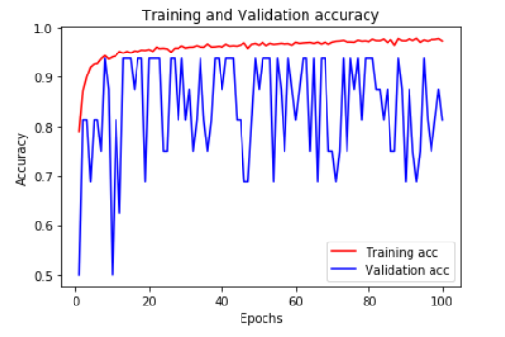
NEURAL NETWORK: BASELINE MODEL
Base Keras model obtained 98% accuracy on training images
Only 74% accuracy on testing images

Slide 6
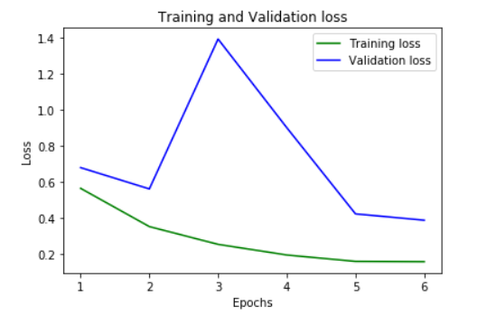
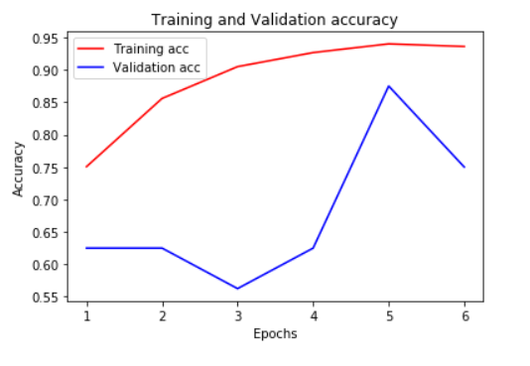
Convolutional Neural Network
Testing image accuracy 80%
6% increase on individual subtleties
Greater usability with newer images

Slide 7
Future Recommendations
Optimize Neural Network
Increase testing time
Increase testing data sest

Slide 8

Thank You

